Slide 1
IPv6 over Link-Local Discovery Protocol
draft-richardson-anima-ipv6-lldp
M. Richardson
Liang Xia
Jie Yang(presenting)
IETF 107, ANIMA

Slide 2
Discovery of adjacent systems
Pledge
(IDevID)
Join Proxy
Domain Registrar
(PKI RA)
Internet
MASA
BRSKI-EST
BRSKI-MASA
Discovery:
over IPv6 Link-local
e.g. RFC7030
Voucher
(RFC 8366)
Key Infrs.
(e.g. PKI CA)
“Domain” components
The pledge talk to Join Proxy using IPv6 Link-Local Address
On the ACP, Need hop-to-hop discovery of adjacent system
But this is in Campus L2 systems

Slide 3
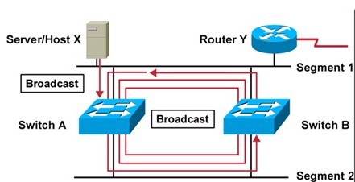
Bootstrap Interlocking Problem
Stable SDN connection can provided by RFC8368.
(RFC8368 : Using an Autonomic Control Plane for Stable Connectivity of Network Operations, Administration, and Maintenance (OAM))
But before the connection, Broadcast in this Campus L2 systems, => Loop
Need additional mechanism for Loop-breaking
Like STP …
But Can’t automatically configure during on-boarding process

Slide 4
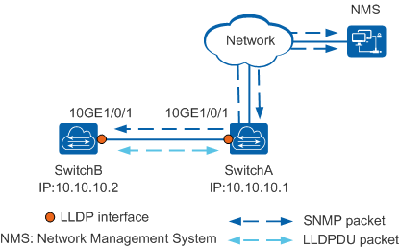
Proposed LLDP Solution
LLDP(Link Layer Discovery Protocol) Description:
Standard Layer-2 discovery protocol in IEEE 802.1ab, without Control Plane
Does not forward packets with default, that is : it discovers all compliant layer-2 devices in a network, even if they do not normally do layer-3 forwarding
Process for LLDP frames:
Be sent to the control plane processor, -> exactly the desired for ACP: all traffic goes to the control plane processor.

Slide 5
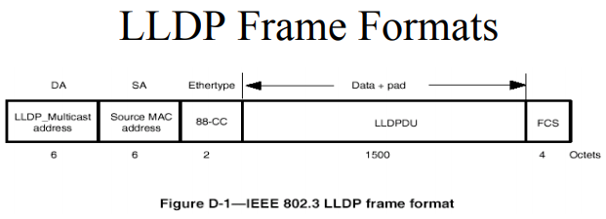
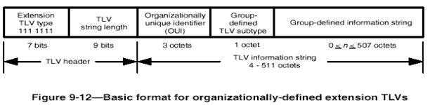
LLDP Encapsulation expecting your valuable suggestions
507 octets limit the vendor-specific frame:
minimum MTU in IPv6 protocol standard : 1280
So LLDP IPv6 fragment contain more than one TLV, accommodate up to 1500bytes(often larger…) in Ethernet network
Issue of Subtype TLV values: which better?
Option-1: Multiple different subtype values
Option-2: Repeatedly same subtype TLV values
How to keep the correct order?
Issue of Content payload : which option?
Option-1: entire IPv6 packet
Option-2: elided IPv6 packet
Option-3: compressed packet, RFC8138 or others?
Vendor-specific TLV : 127
IANA unique
TBD
IPv6 fragment : up to 507 octets
Notes:
bootstrap interlocking problem

Slide 6
Thank You!

